Slide 1
John Mark Agosta San José State University & Fondata.ai 8 April 2025
Workshop on Bayesian Methods in Practice
Integrating Decision Analysis and Data Science
Notes:
Data in
/Users/jma/repos/aipython/data/datasets.ipynb

Slide 2






John Mark Agosta Ex-Microsoft, Azure Machine Learning Lecturer San Jose State University Founder Fondata.ai
Applied Researcher / Data Scientist
SRI International, Intel, Toyota, Microsoft
University - Industry Research projects
Initiated and led projects with
Stanford, CMU, U. Pittsburgh, Toronto, UC Riverside
PhD MS&E
Initiatives
Co-founded Bayes Application Workshop, 16 years running
Awarded Santa Fe Institute Business Fellowship
Singer
Slavyanka, Bay Area Slavic Chorus
BS Physics

Slide 3

Some familiar terms
Machine Learning – Statistical estimation from data
ML models produce predictions
Decision Analysis – Applied Decision Theory
Decision models prescribe actions.
Bayes network and Probabilistic Graphical Models,
Directed A-cyclic graphs that factor joint probabilities, for computational purposes
Influence Diagrams
Bayes networks with added decision and value variables.

Slide 4
“Intelligence” is Rational choice.
A decision makes a tangible change; an allocation that is not revocable.
A rational decision aligns actions to maximize a measure over outcomes
Outcomes can be assigned values by which they can be compared
Predictions are uncertainties over outcomes, expressed by probability
“Intelligence”
is
Rational Choice

Slide 5





* Influence Diagrams, aka - Bayes Networks, - Probabilistic Graphical Models - Structural Equation Models have three kinds of variables. * Arcs show the influences among them * Decision models, as one might draw out in a tree, can be formulated and solved by Influence Diagrams
These are the 3 kinds of variables:
Outcome values
Conditional probabilities
Decisions, policies

Slide 6
Influence Diagrams are concise, causal, and computational
c₁
V(c₁, f₁)
A|F
C(A)
F
F | a₁
V(c₁, f₂)
a₁
c₂
V(c₂, f₁)
C
F
V(c₂, f₂)
A
a₂
c₁
V(c₁, f₁)
C
F
F
V(C,F)
V(c₁, f₂)
C | a₂
c₂
V(c₂, f₁)
F
V(c₂, f₂)
Equivalent
Influence Diagram
Tree, With Decision and Outcomes
Notes:
A aircraft
C change flight
F my flight delayed

Slide 7
The marriage proposal: A coupled influence diagram – statistical model
”Used Car Buyer:” An influence diagram: “test before purchase”
Informed by a data set of previous test results.
Estimate a “classification tree” to predict test results from data
Introduce model priors when learning the tree.
Use the classification tree to create the influence diagram probability model.

Slide 8

Why? Because conventional statistic methods don’t work
Why is this hard?
Statistical ”confidence” (p-values) are not the probabilities, needed and don’t work in an influence diagram
How to resolve this?
Creating a Bayesian model from data that can accept priors and obtain the required posterior probability of outcomes

Slide 9
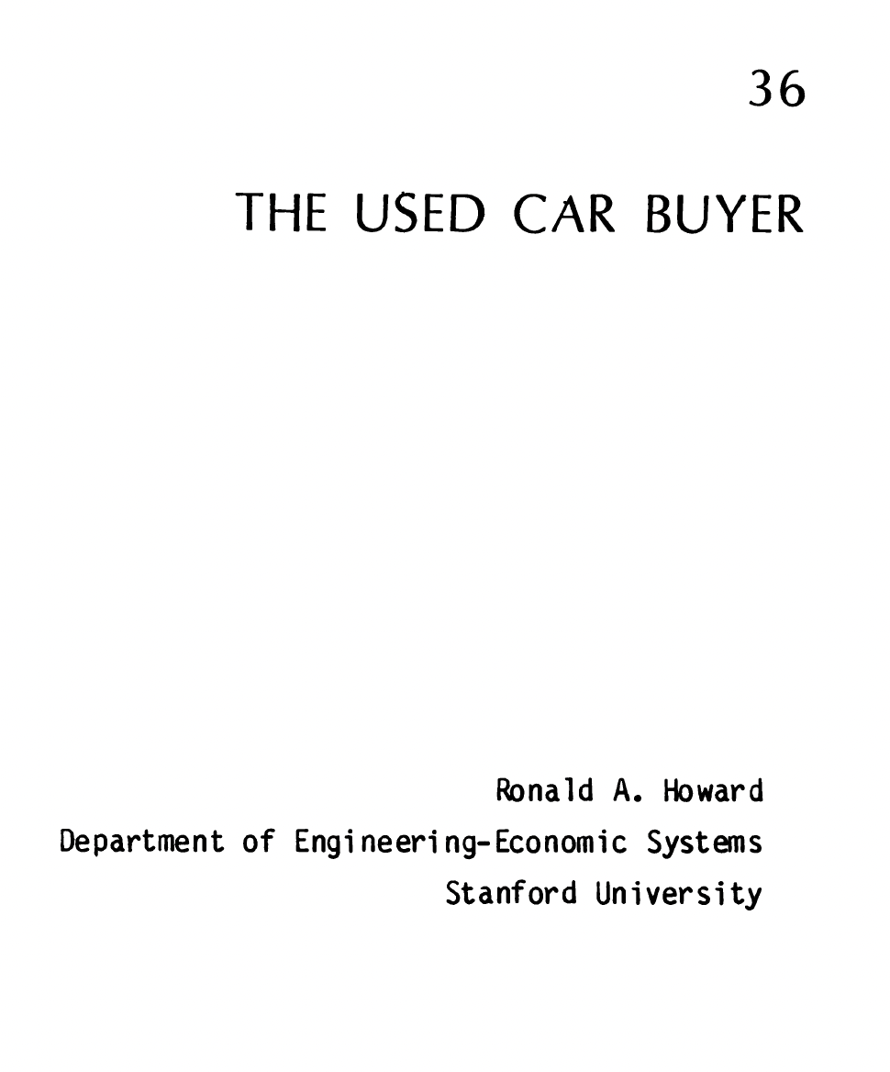
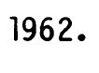
Notes:
Describe what the model consists of and a bit of its history

Slide 10
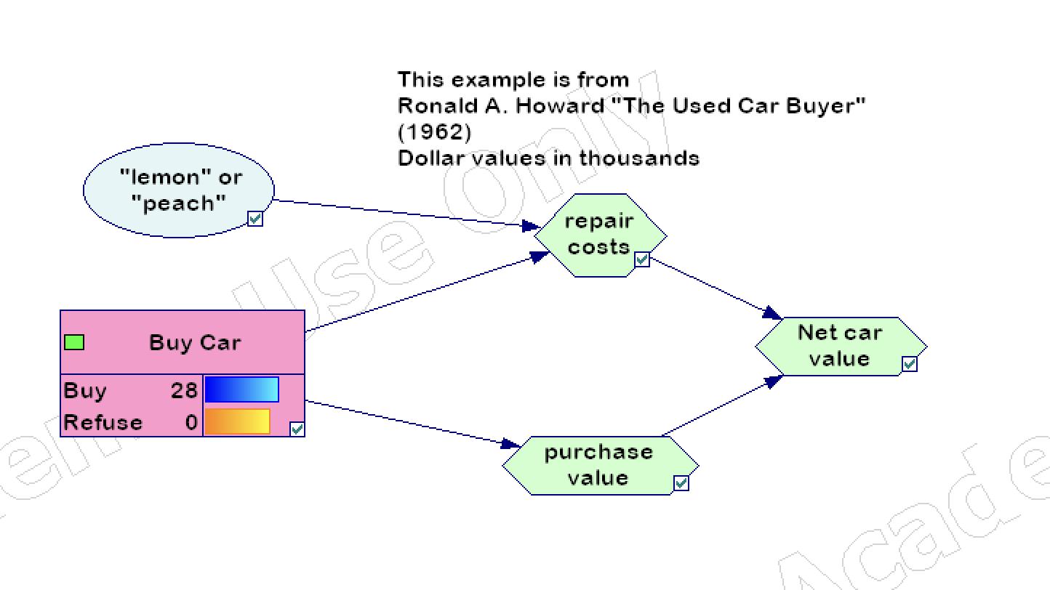

Slide 11
P(”lemon” or “peach” | ig, carb, door test )
Model Posterior probability

Slide 12
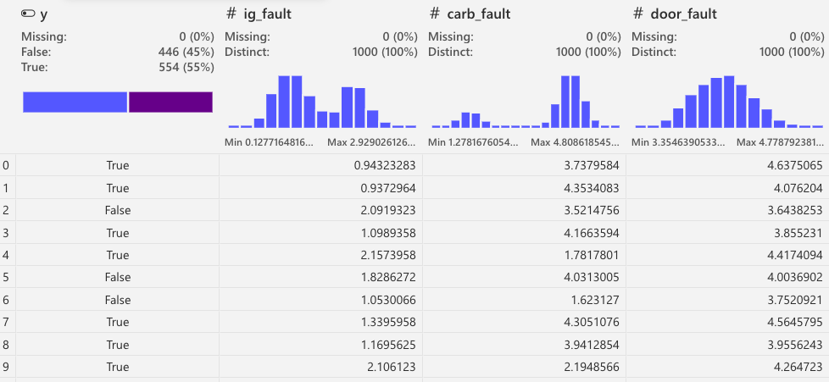

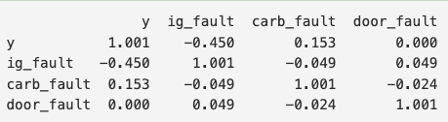
Simulated data from a history of past test results
Correlation matrix

Slide 13
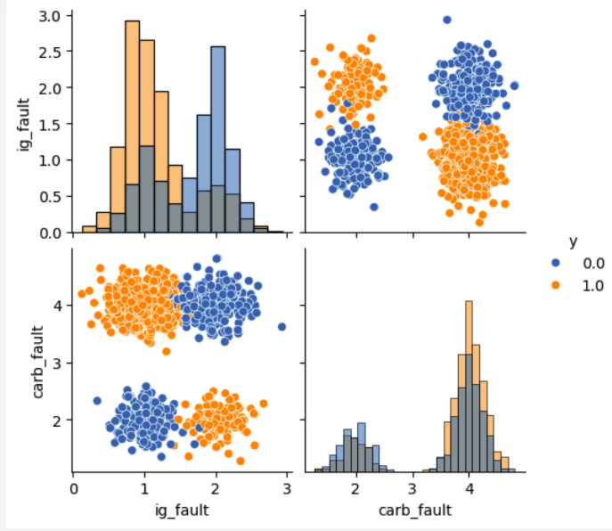
For faulty cars, measurements “ignition_fault” and “carburetor_fault” tend to coincide
z
Lemon
Peach
Notes:
This non-linear dependency is hard to recover with linear models, but well suited for classification trees.

Slide 14
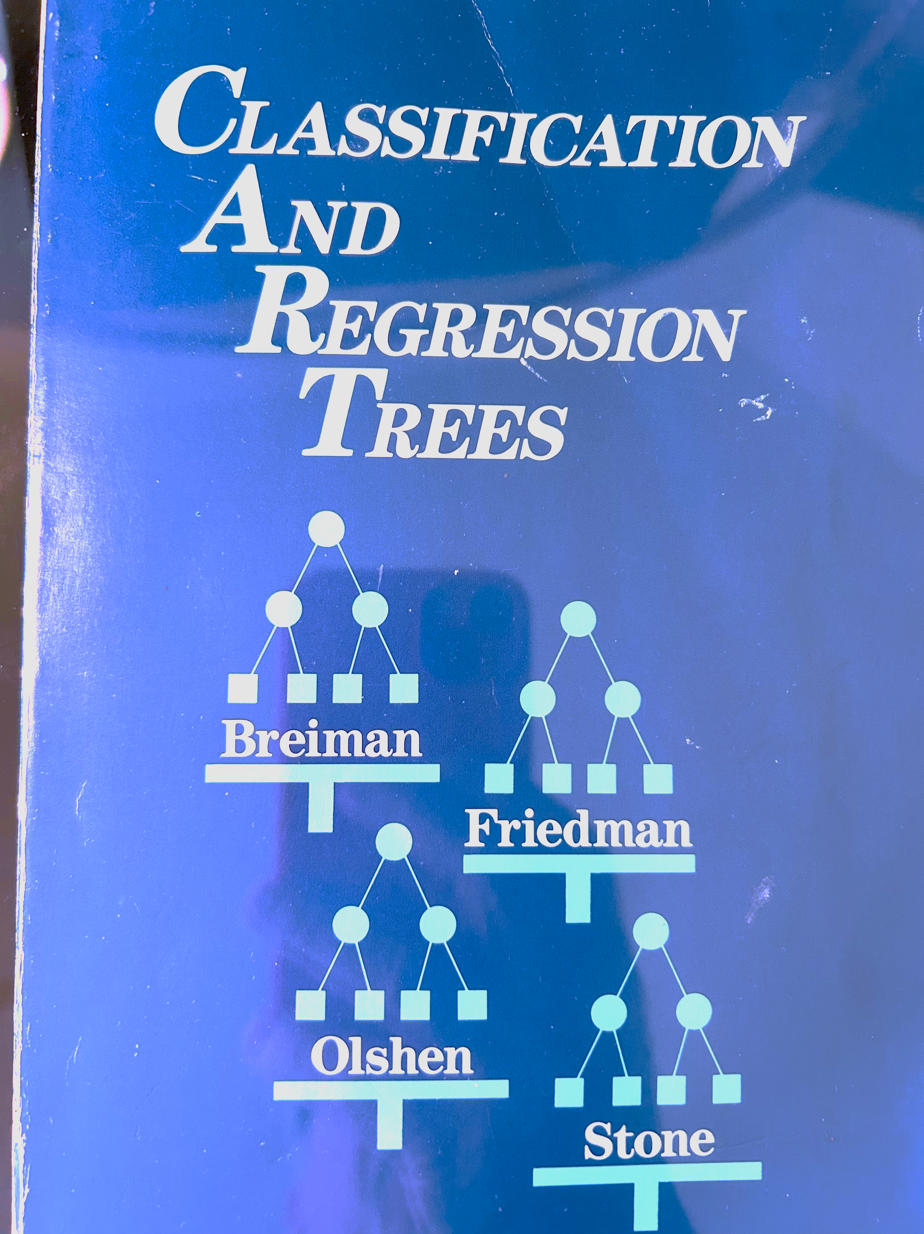
A Classification Tree learns the probability distribution of the outcome from data

Slide 15
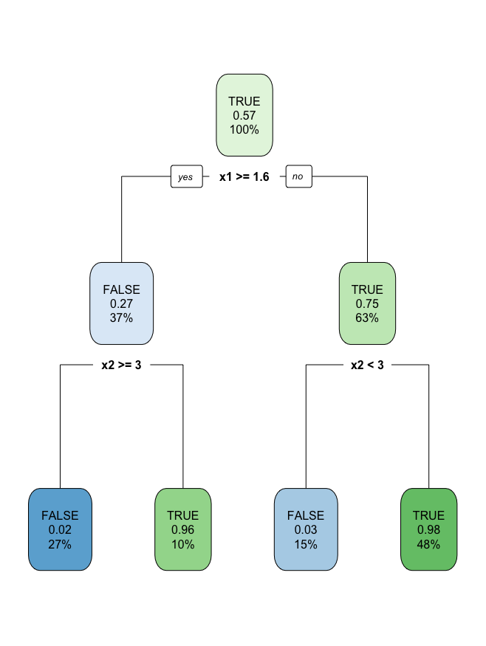
Classification tree for simulated data.
The splits learned by this tree become the states, (e.g. the partitions) that define the observable variables for the decision node.
The probabilities learned by the tree are used in the decision model to compute expected value (and hence VOI) for the decision.
The probabilities learned by the Tree depend on the prior assumed for the unobserved state variable.
The tree ignores irrelevant variables – you get variable relevance for free.
lemon
peach
lemon
peach

Slide 16
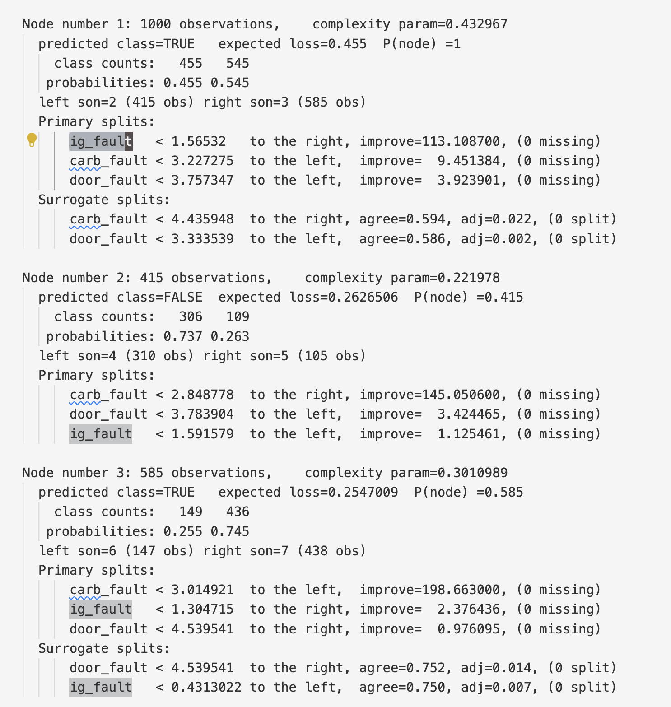
CART output

Slide 17
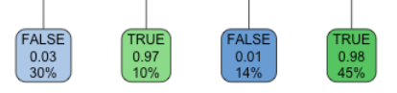

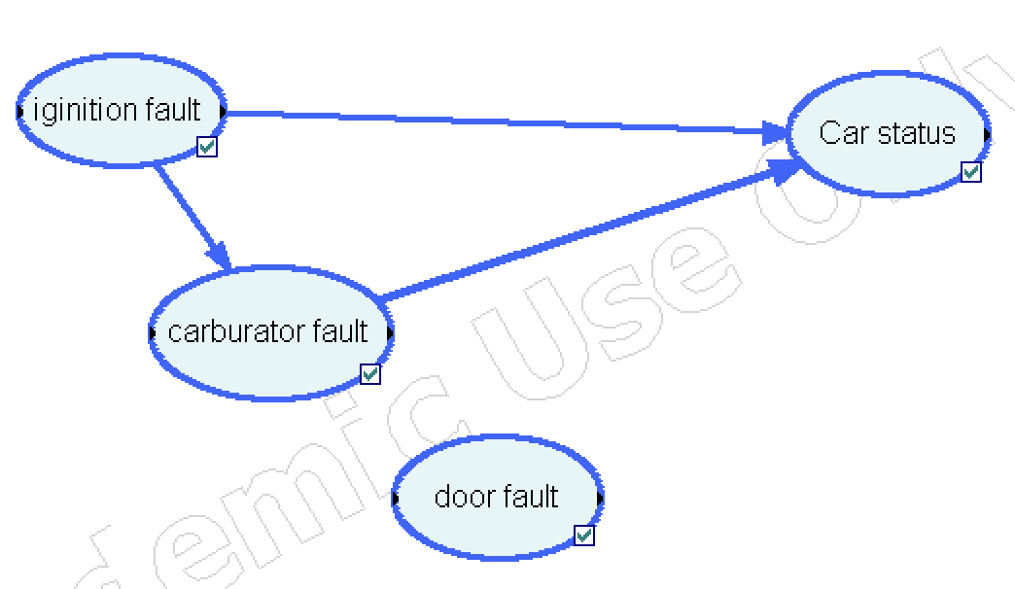
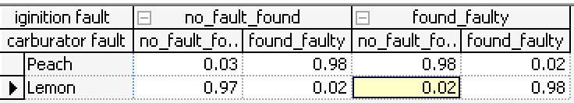
The leaves of the Classification Tree create the Car Status conditional probability table.

Slide 18
P(“lemon” | data ) ≠ P(“lemon” | 𝓔)
What if the prevalence in the historical training data
does not equal the elicited prior?
Not a problem!

Slide 19
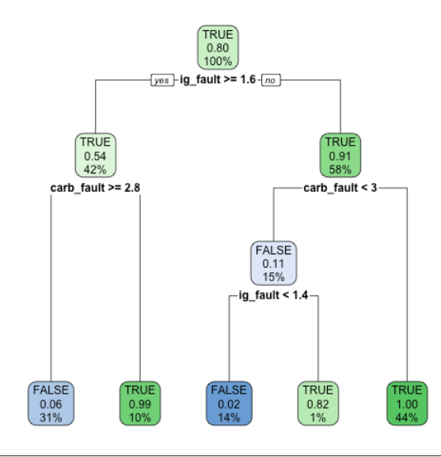
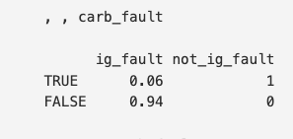
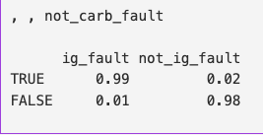
Updating the class prior
Using the car “lemon-peach” prior from the influence diagram when re-training the test classifier modifies the prediction probabilities, incrementally improving its performance.

Slide 20
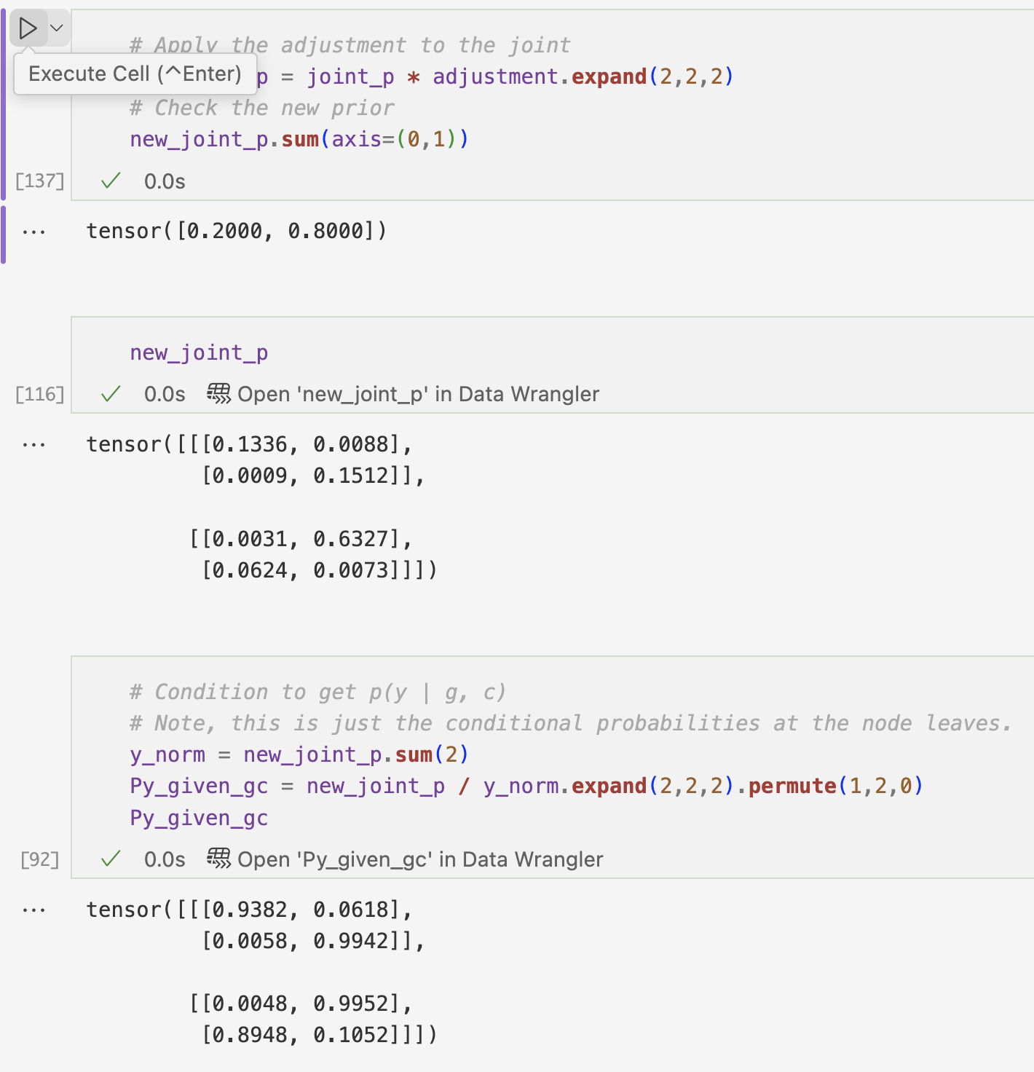
Adjusting the priors Bayes to the rescue!

Slide 21
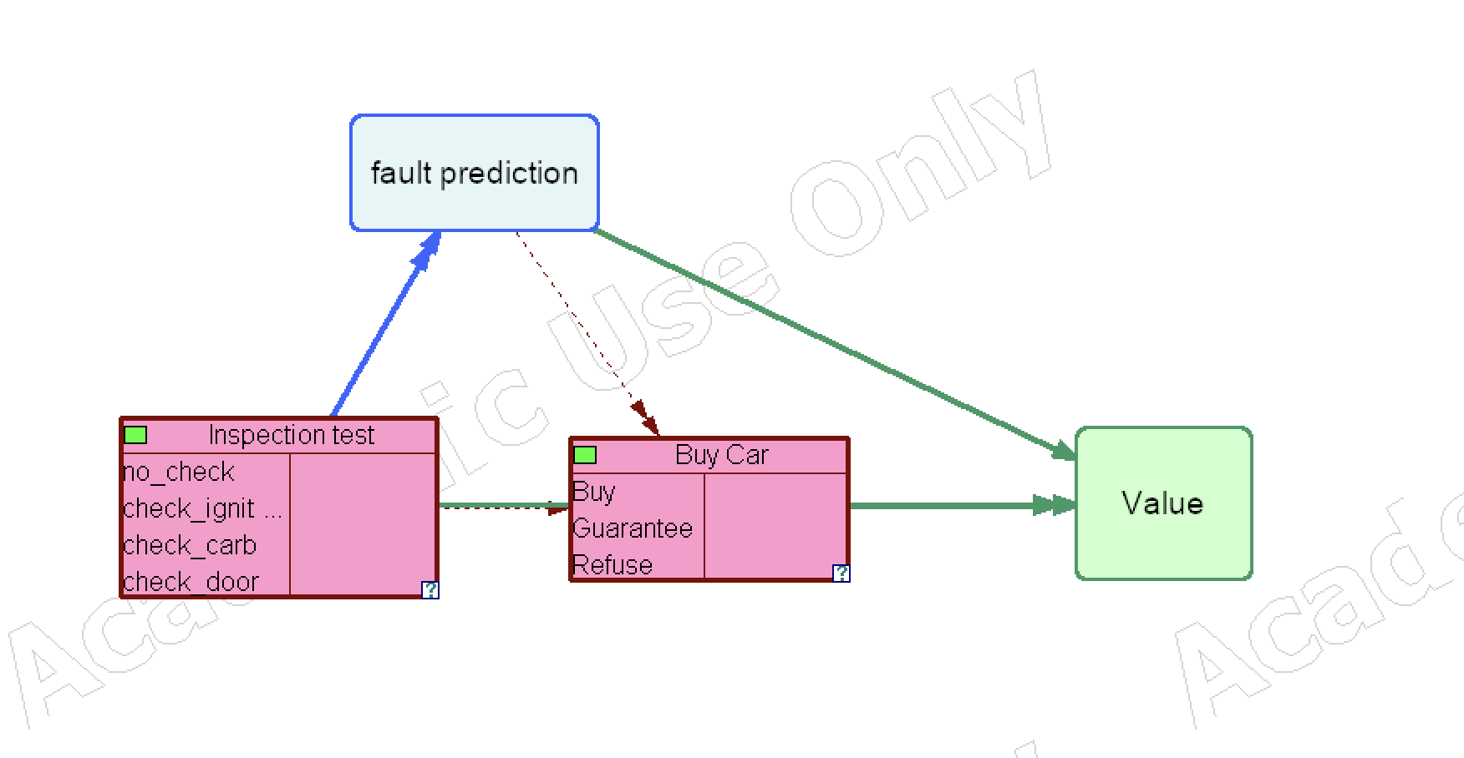
The “test then buy” influence diagram by adding the prediction model to the Used Car Buyer value model

Slide 22
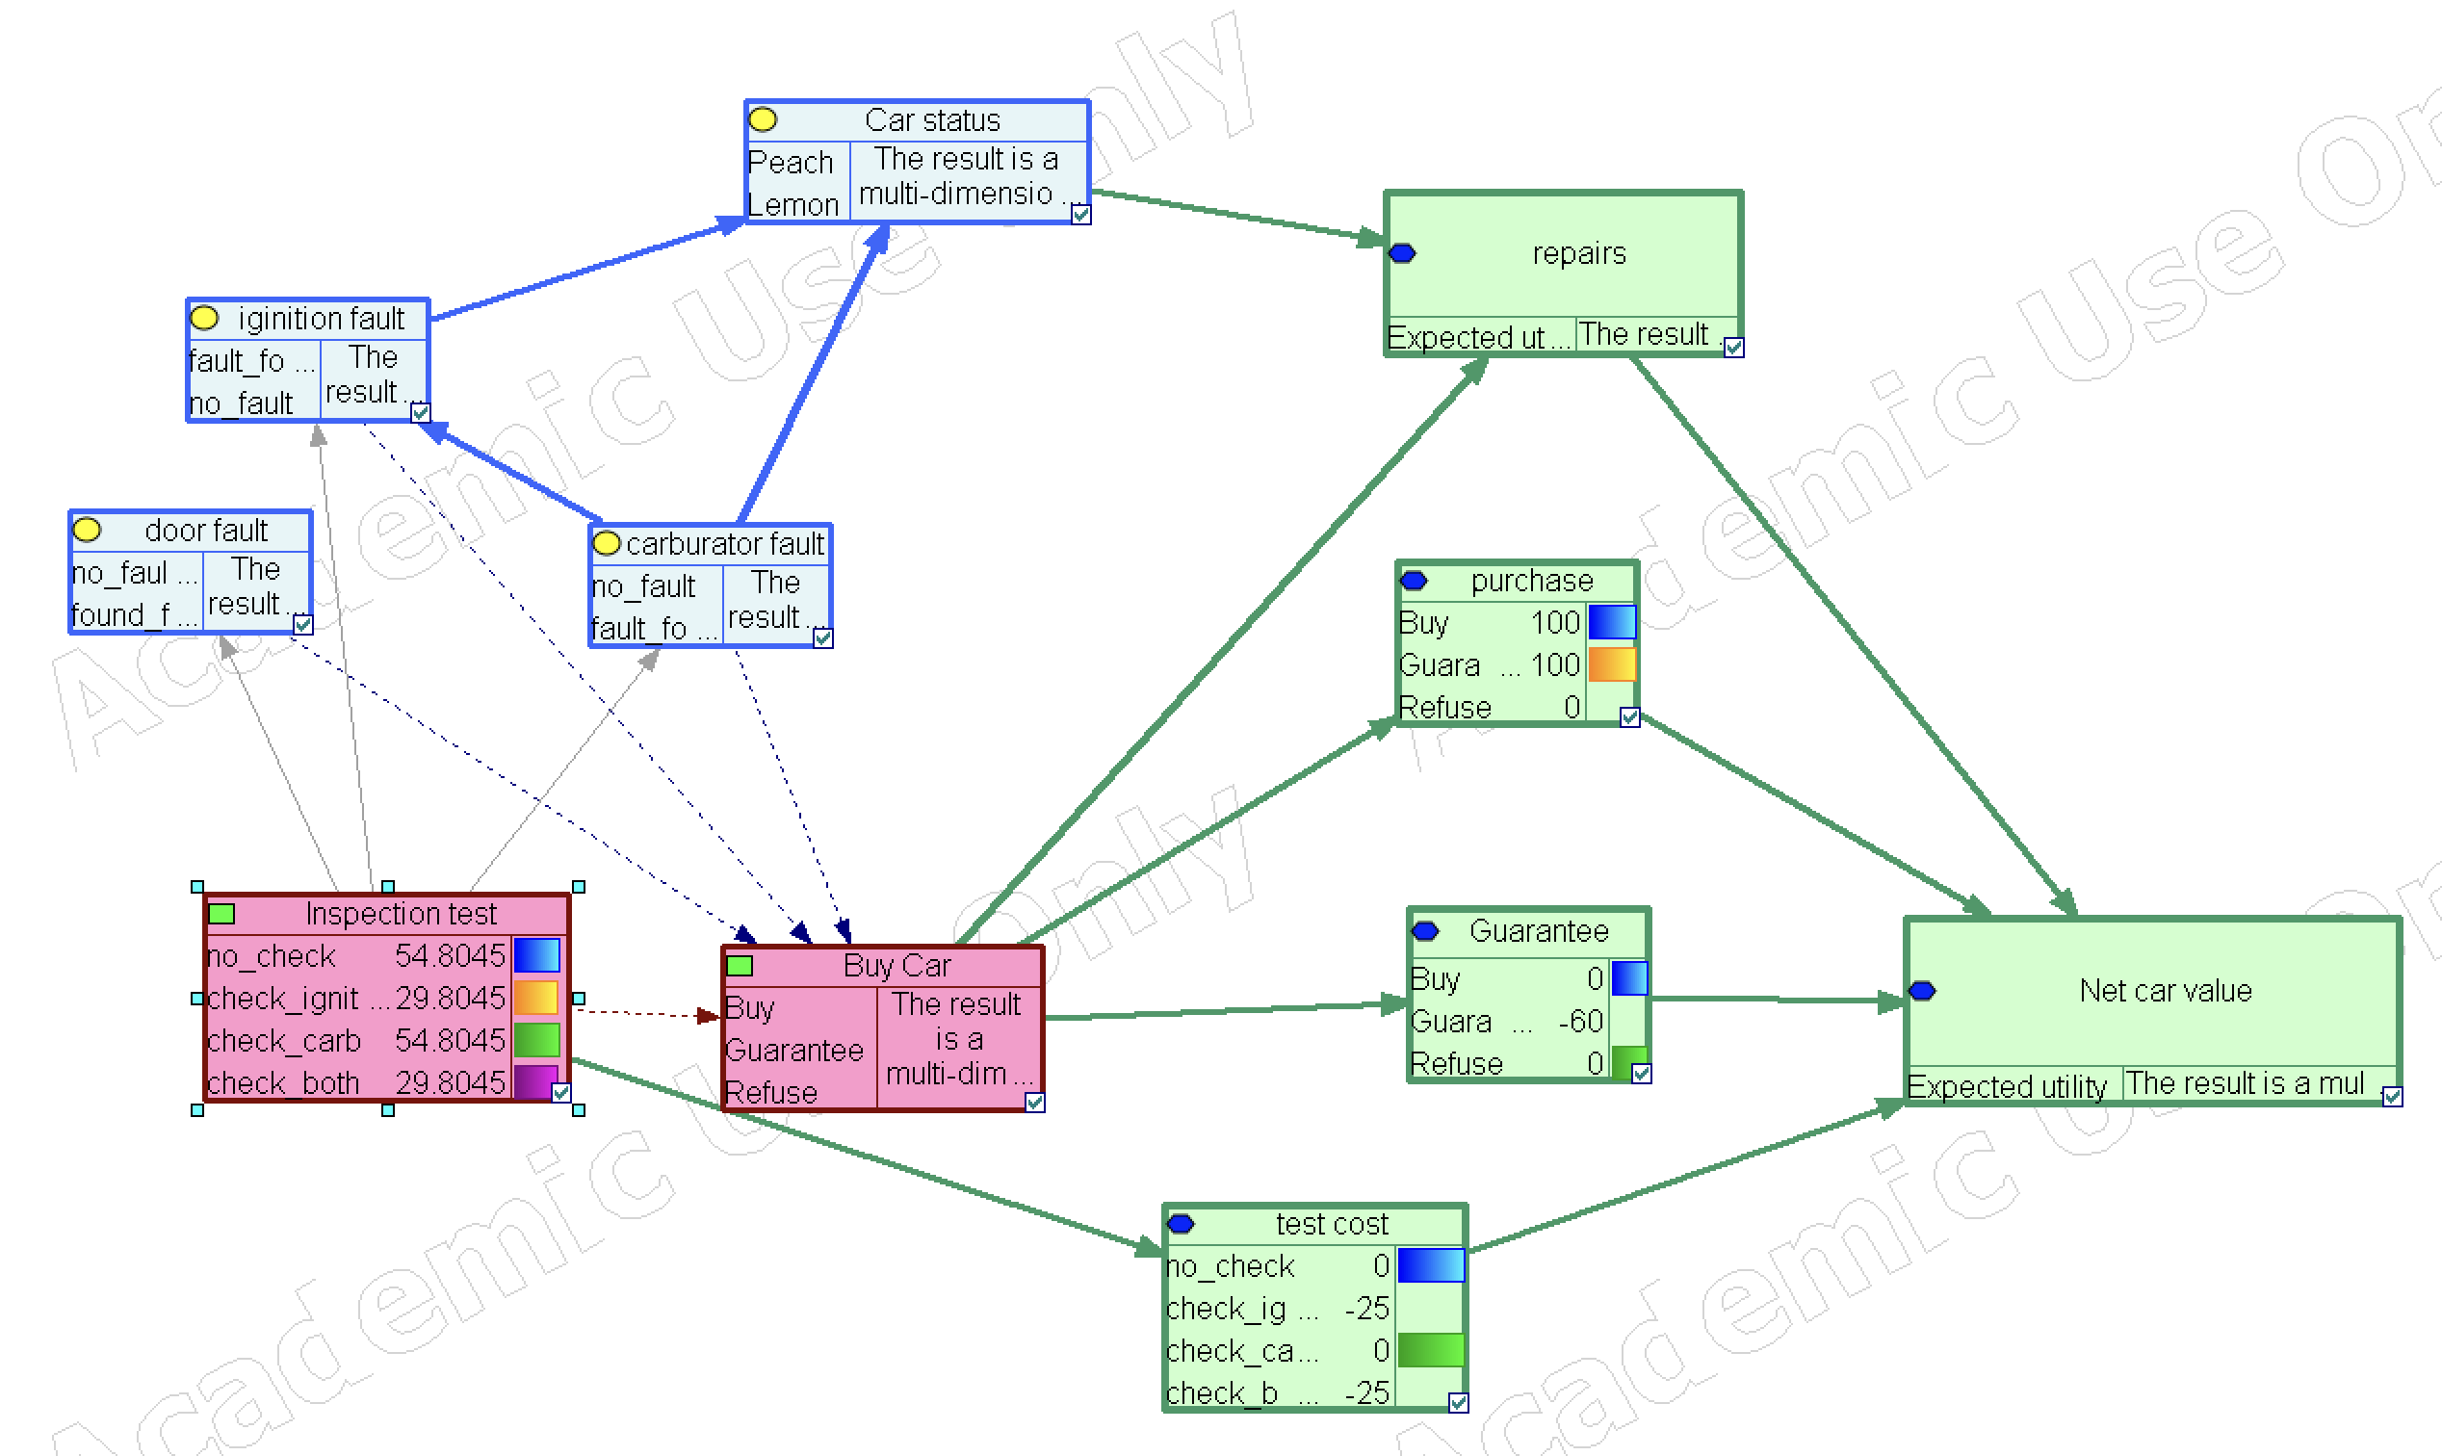
Expanding the prediction and value sub-models
to show the full influence diagram

Slide 23
Applications: Where is Decision Modeling Useful?
Decisions with significant uncertainty:
Product management: Selection of new features
Cloud automation: Model deployment
Operations: Optimal supply chains
Healthcare: Treatment choices

Slide 24
The take-away
Derived from a common mathematical framework,
Data Science predictive models and
decision analysis models
can combine
Bayesian statistics and
decision theory.

Slide 25
Abstract
Decision Analysis (DA) and Data Science teams often operate at cross-purposes, using distinct frameworks. The aim of this work is to demonstrate how current machine learning methods can be applied in a principled way to Decision Analysis. For example, machine learning methods do not make the prior explicit, but directly estimate posterior predictive distributions. Estimating likelihoods instead avoids this confounding. Extending well-known textbook examples, such as value of information analysis, with estimation of likelihoods illustrates how this is possible. The result is a novel analytical approach that combines software tools that solve influence diagrams with Bayesian statistical methods. This advances the computational aspects of Decision Analysis, aligning it with contemporary evidence-based practices.

Slide 26
Artificial Intelligence?
“AI” means many things. It brings an eclectic mix of methods developed over the last 50 years -- from OR, Statistics, NLU, Optimization, Cognitive Science….
Key concepts:
Rationality, “alignment” – matching means and ends
Explainability – “heuristic adequacy” – answering why
Subjectivity – “Inductive bias” - respecting human input & opinion
Automation – “Agency” – autonomous actions by machines
Uncertainty – “Probability calculus” - What good is an inaccurate (e.g. statistical) model?
Computation – Simple things done at massive scale
Decision focus – Start by examining possible actions.

Slide 27
Premise: “Intelligence” is Rational choice.
A decision makes a tangible change; an allocation that is not revocable.
A rational decision aligns actions to maximize a measure over outcomes
Outcomes can be assigned values by which they can be compared
Predictions are uncertainties over outcomes, expressed by probability

